Slide 1
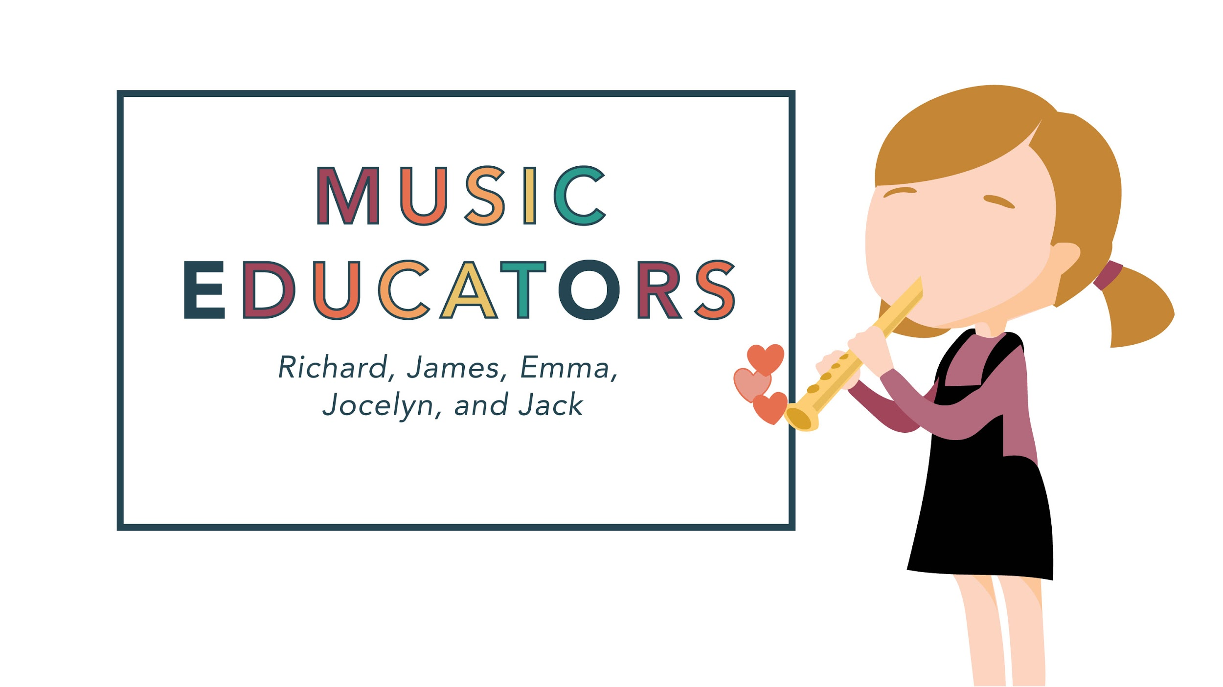
Notes:
Emma

Slide 2
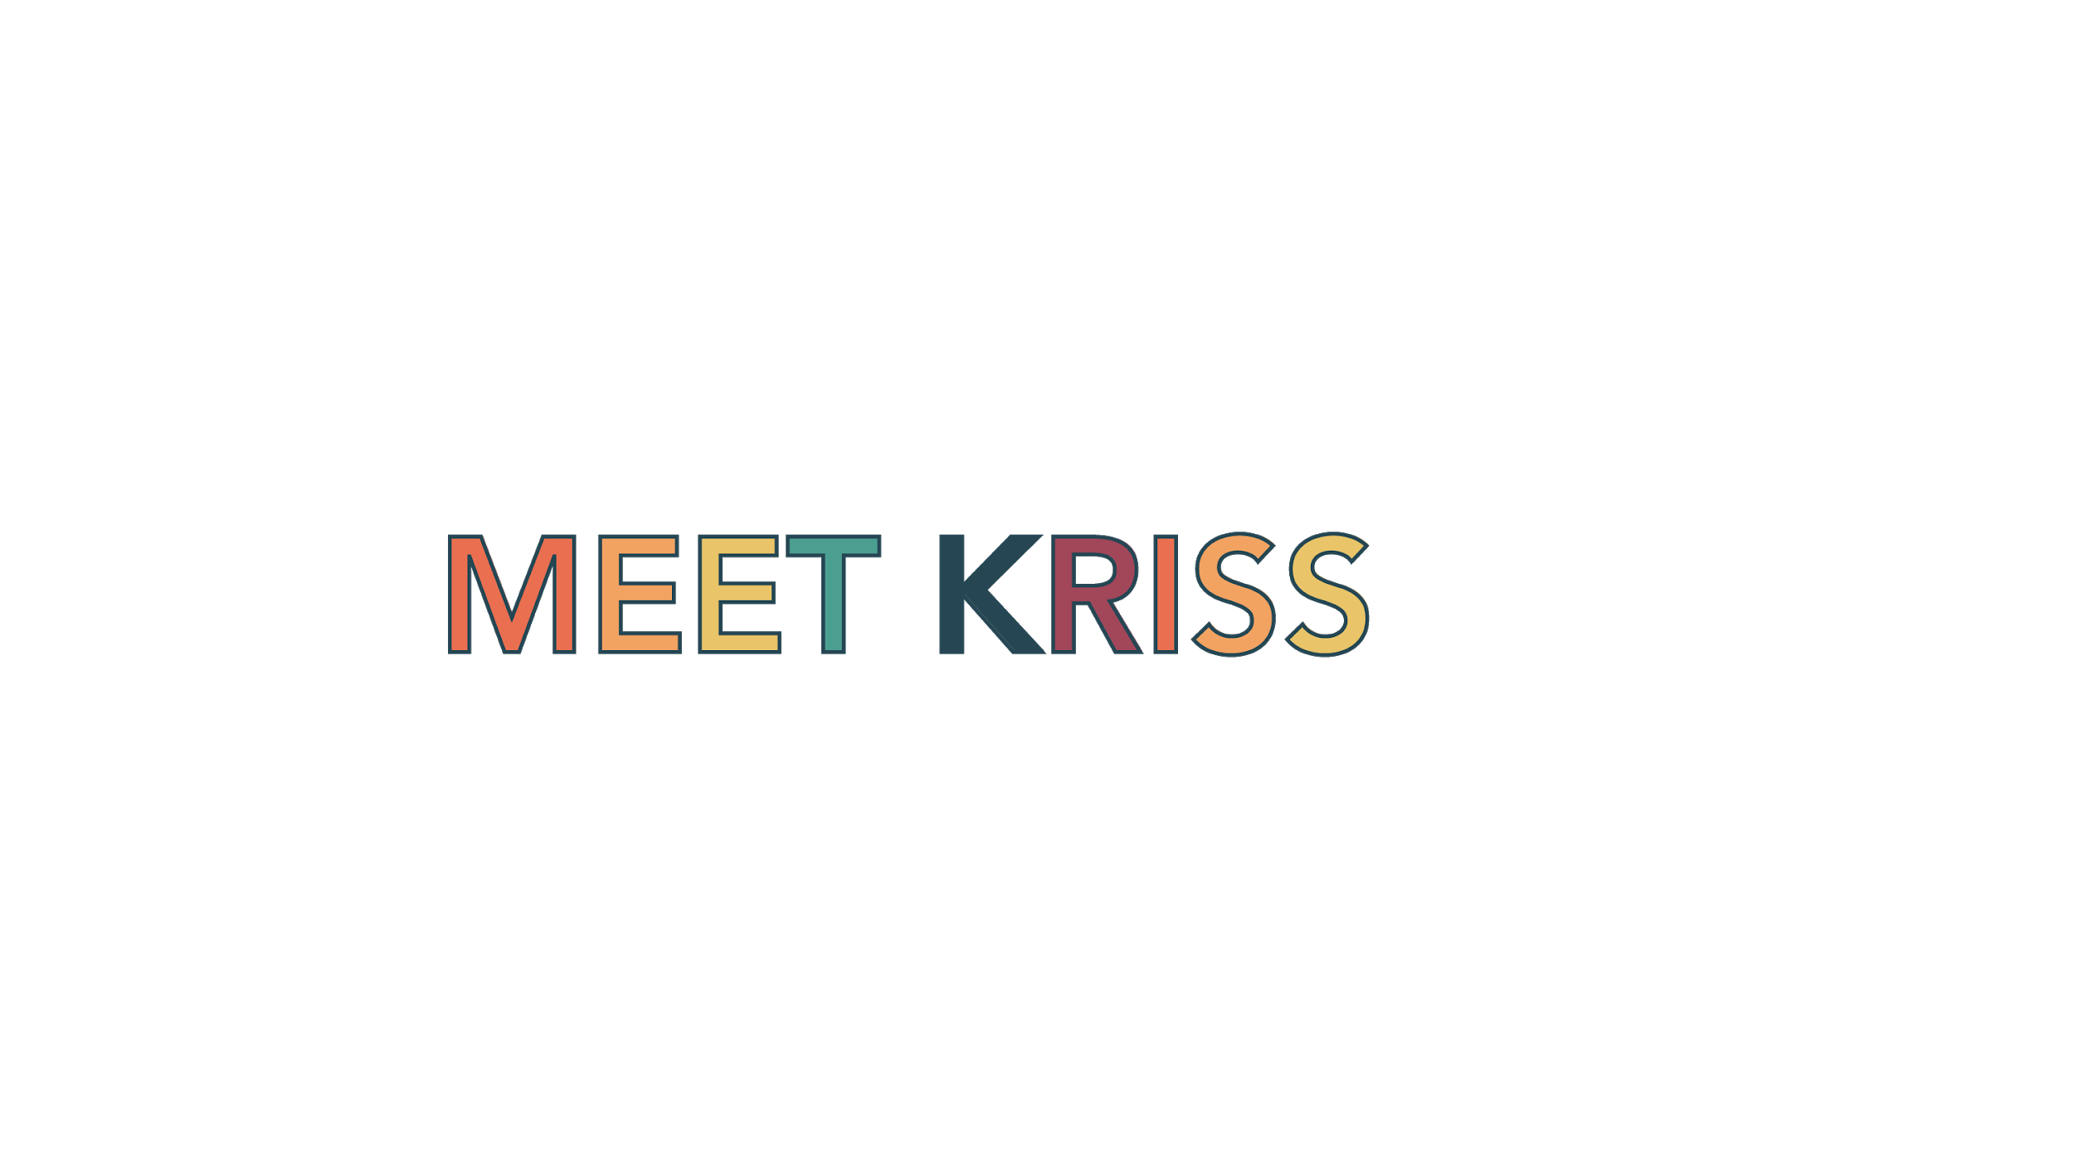
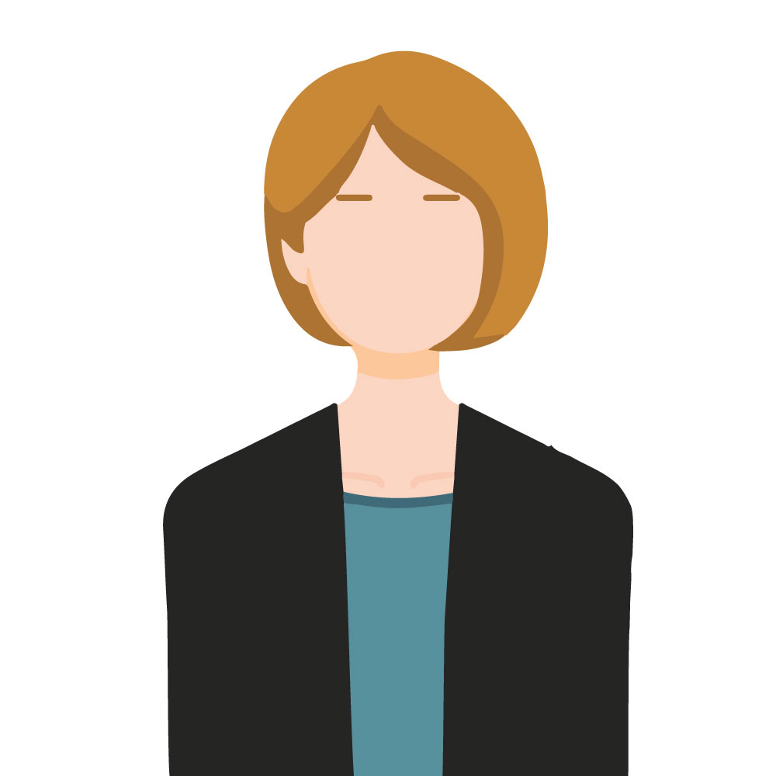
Notes:
James
Meet Kriss. She went to music school for performance but is now a music educator at a K-12 public school.
She has always wanted to perform, but something happened in her life that resulted in self doubt.
She now teaches to share her passion for music. She also gains some validation through her teaching, something she sought through performance
Our mission is to inspire music educators to realize their full potential by enabling experiences that lead to self growth.

Slide 3

Universal sabbaticals for music educators
Notes:
Emma
We will do this by making sabbaticals for people like Kriss accessible and part of the job contract.
Sabbaticals will give music educators the space to explore for a year without the worry of being successful in performance, and the concerns about money that comes with that.
Sabbaticals exist now for the precious few -- they are not universal in higher ed and are extremely rare in grade schools.
We propose that sabbaticals will be particularly impactful for music educators, many of whom followed a similar journey in coming to music education.

Slide 4
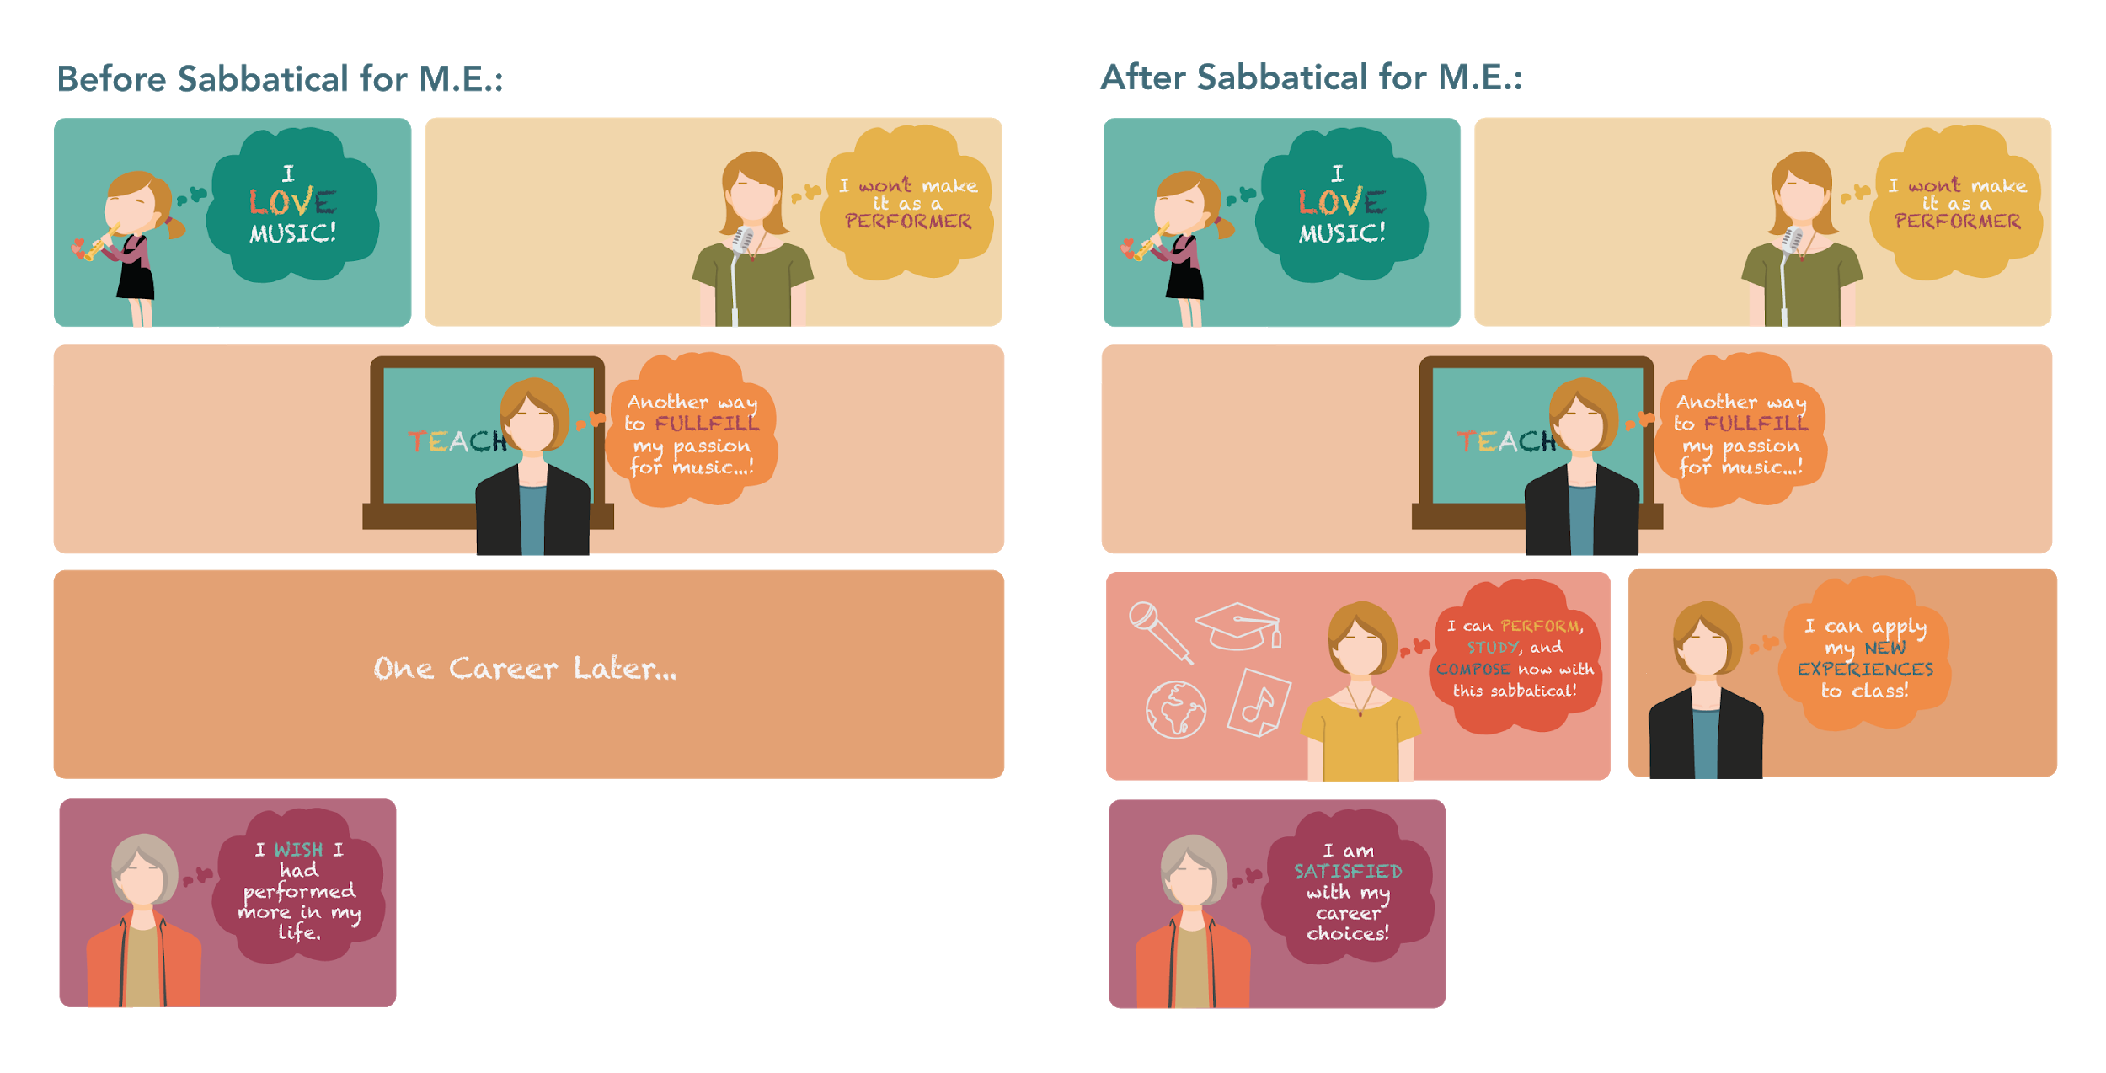
Notes:
Jocelyn
As mentioned before, Kriss’ passion for music and self-doubt drives her to music education. Once she has reach retirement, she wishes she had performed more in her life.
On her sabbatical, she’s able to perform, or compose or write, or do whatever
Give real stories from our real users
Users like Carrie would have appreciated to perform
Janet would compose, perform AND write a book
Once she has explored outside of her career, she is able to come back and apply her wonderful experiences to the classroom. Once she retires, there she will be satisfied with her career and her ability to perform.

Slide 5

Notes:
Richard
Our solution/prototype is an organization called Sabbatical for M.E. (where me stands for music educator) that spreads awareness about sabbaticals as a necessary option that educators should have. It also facilitates the structure behind implementing a sabbatical system.

Slide 6
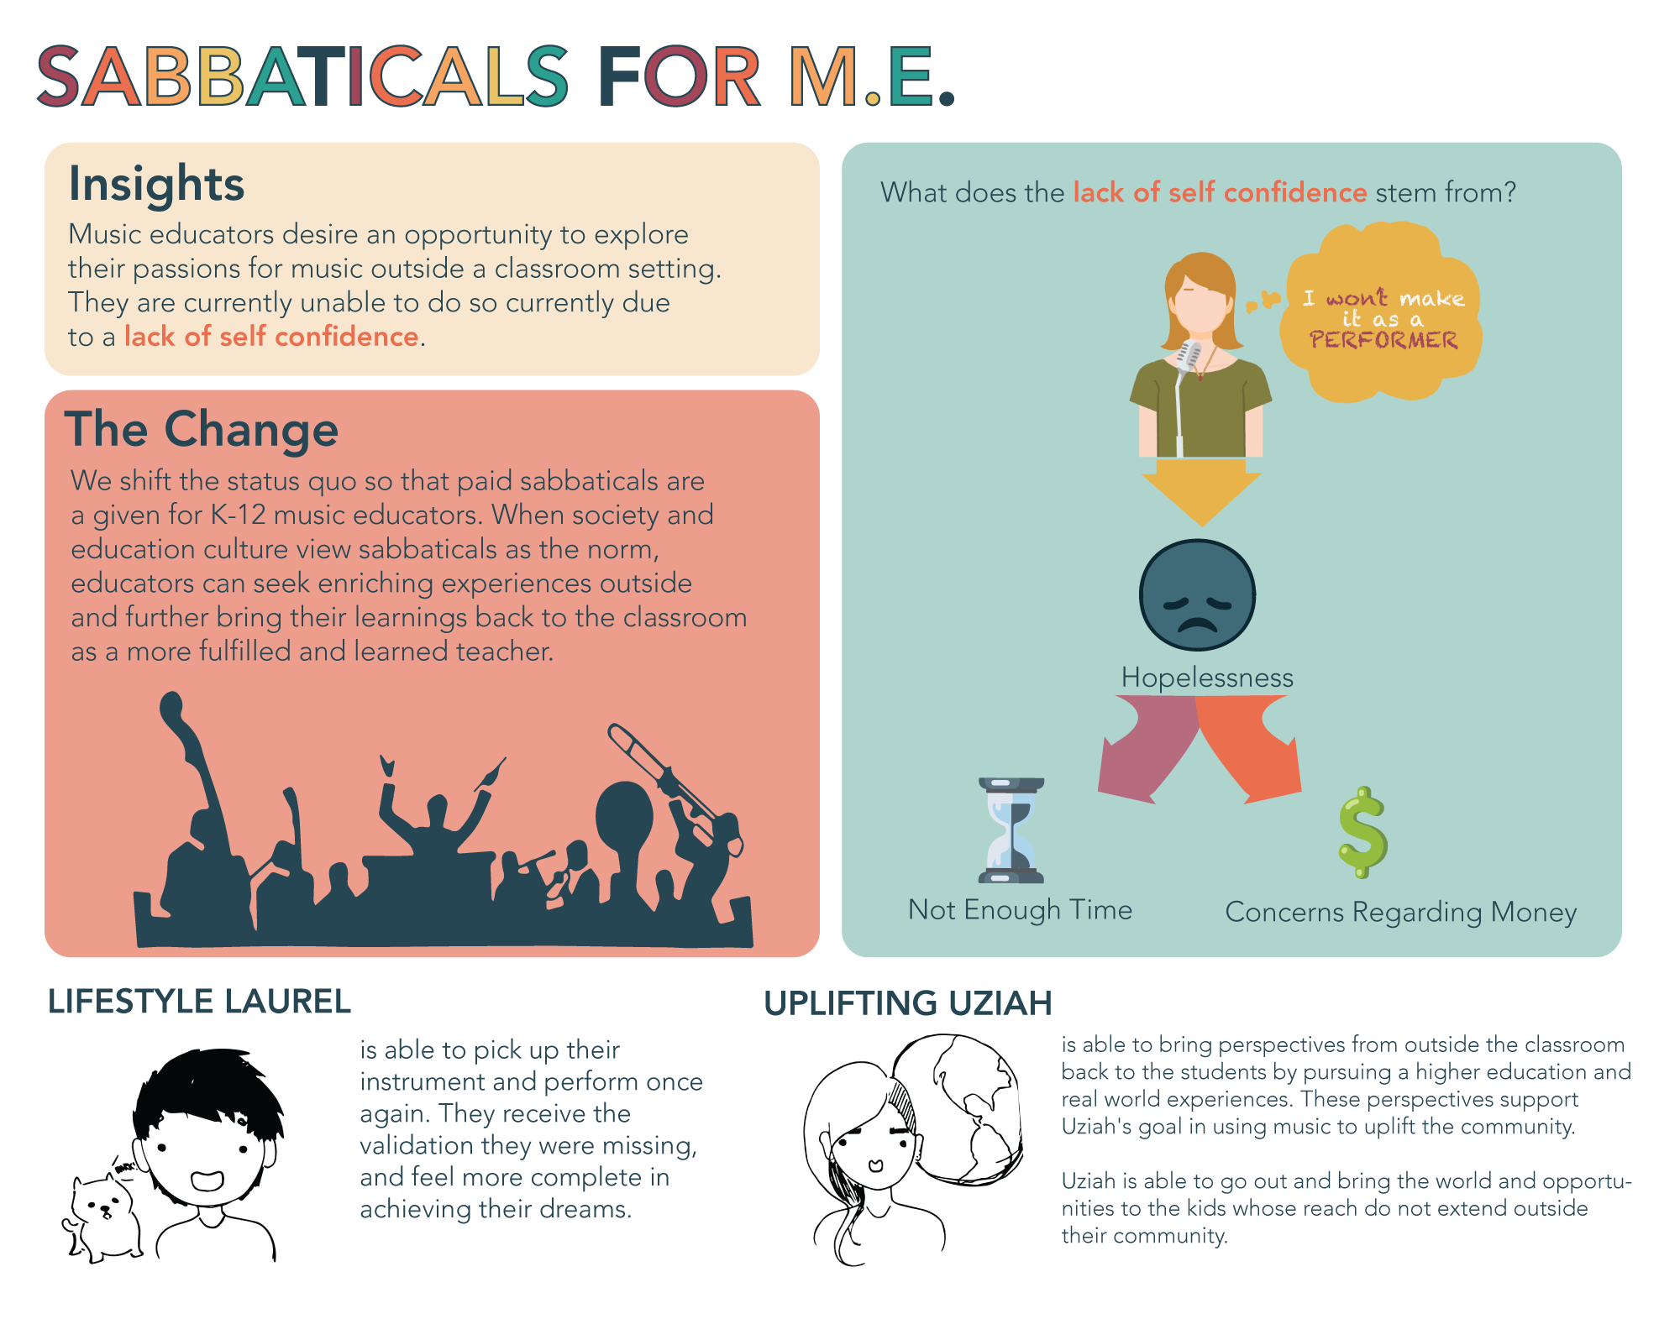
Notes:
Richard
For someone like lifestyle laurel who is hopeless in that they are unable to perform anymore, a sabbatical gives them the freedom to do so, once again giving them the performance validation they have been lacking.
Or someone like uplifting Uziah who given this opportunity can pursue higher education in musical teaching or go out to hold workshops and bring the insights from these experiences back to their kids, showing them what opportunities lie outside their community.

Slide 7
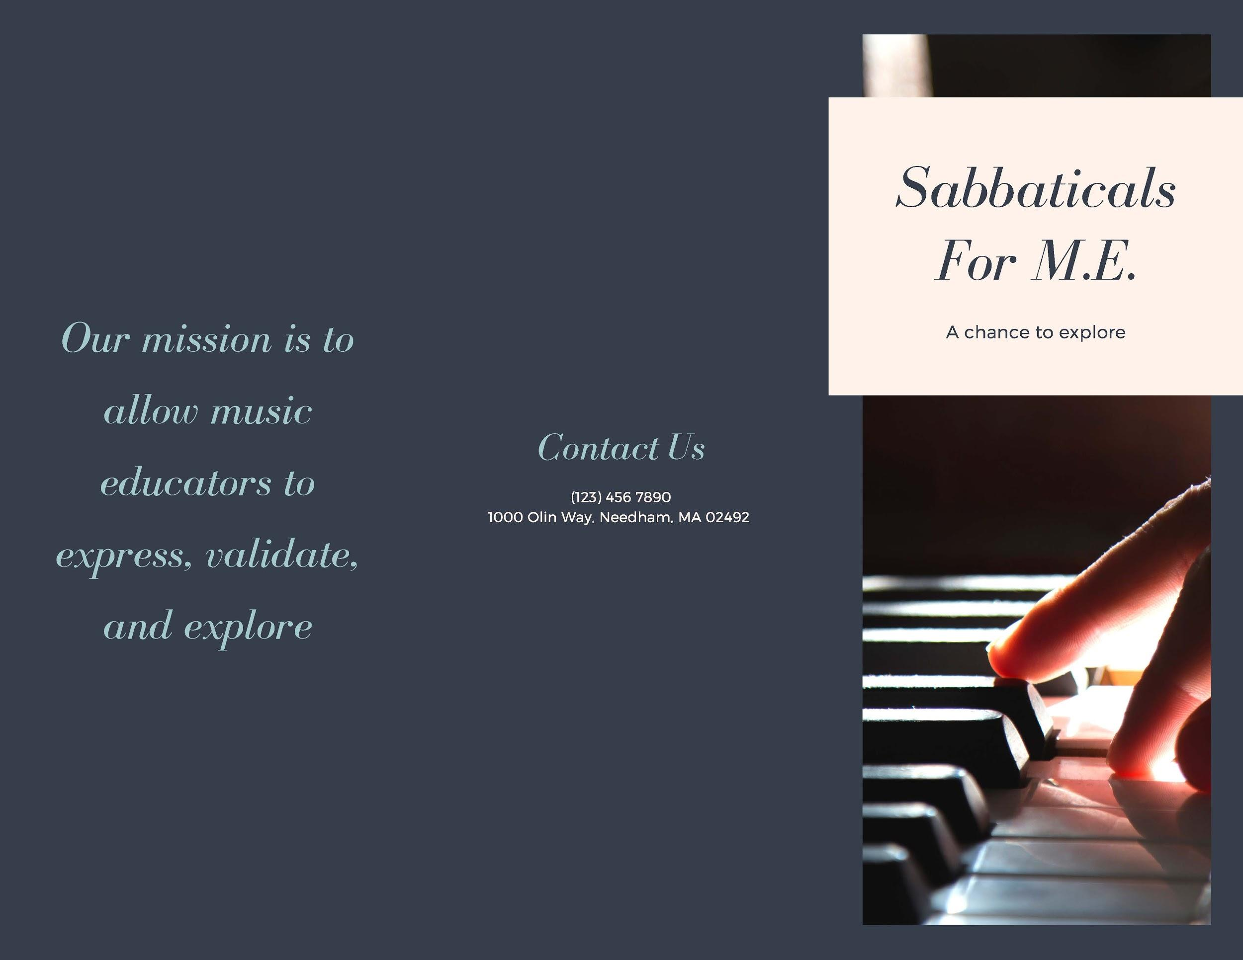
Notes:
Jack
This is the brochure we made which is used to advertise our service, which could be handed out to music educators and philanthropists in the real world

Slide 8
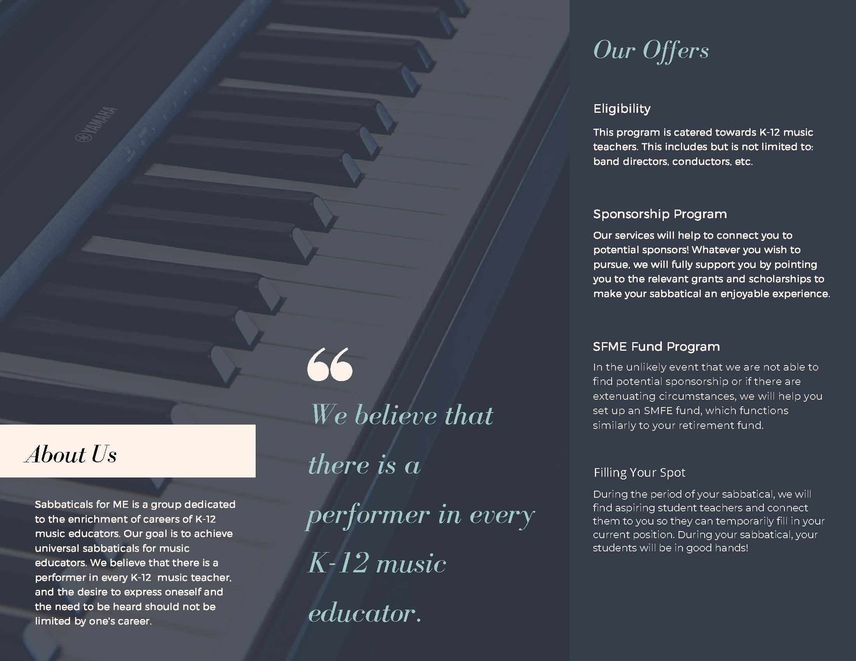
Notes:
Jack
We provide three services, the sponsorship program, SMFE Fund Program, and the Filling Your Spot Program, which we will elaborate on soon. The music educators who are interested in taking a sabbatical would now be able to easily learn of our programs.

Slide 9
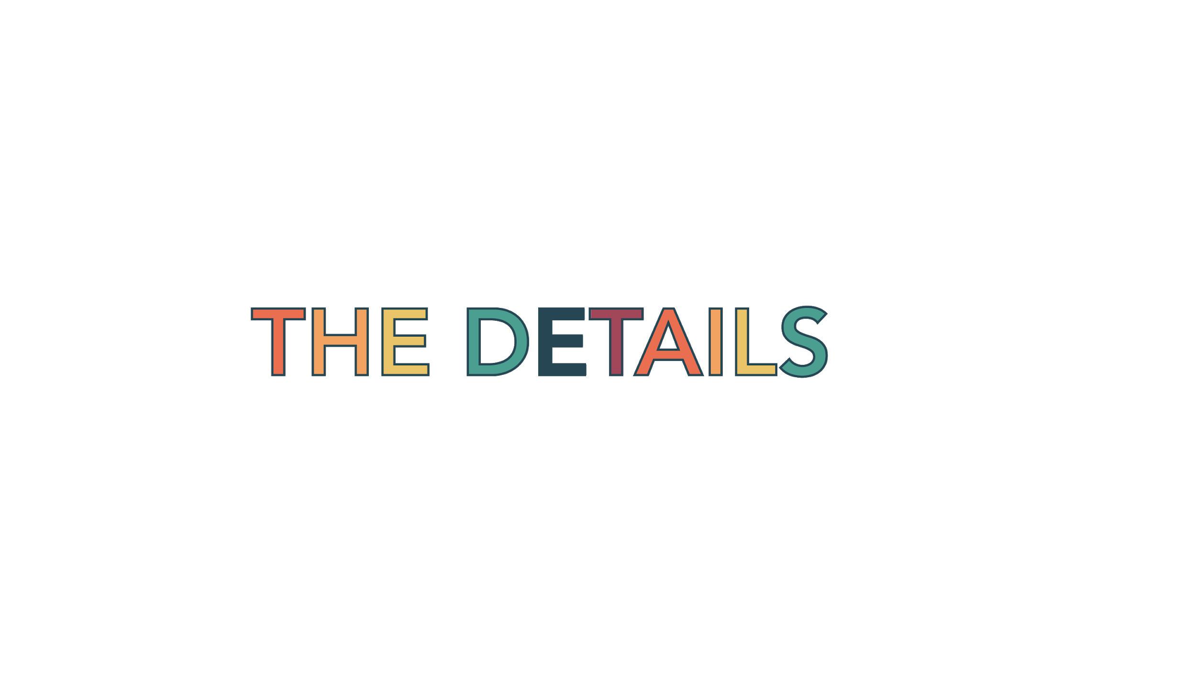
Notes:
Emma
Alright, since we have some time left, now let’s get into the weeds.

Slide 10
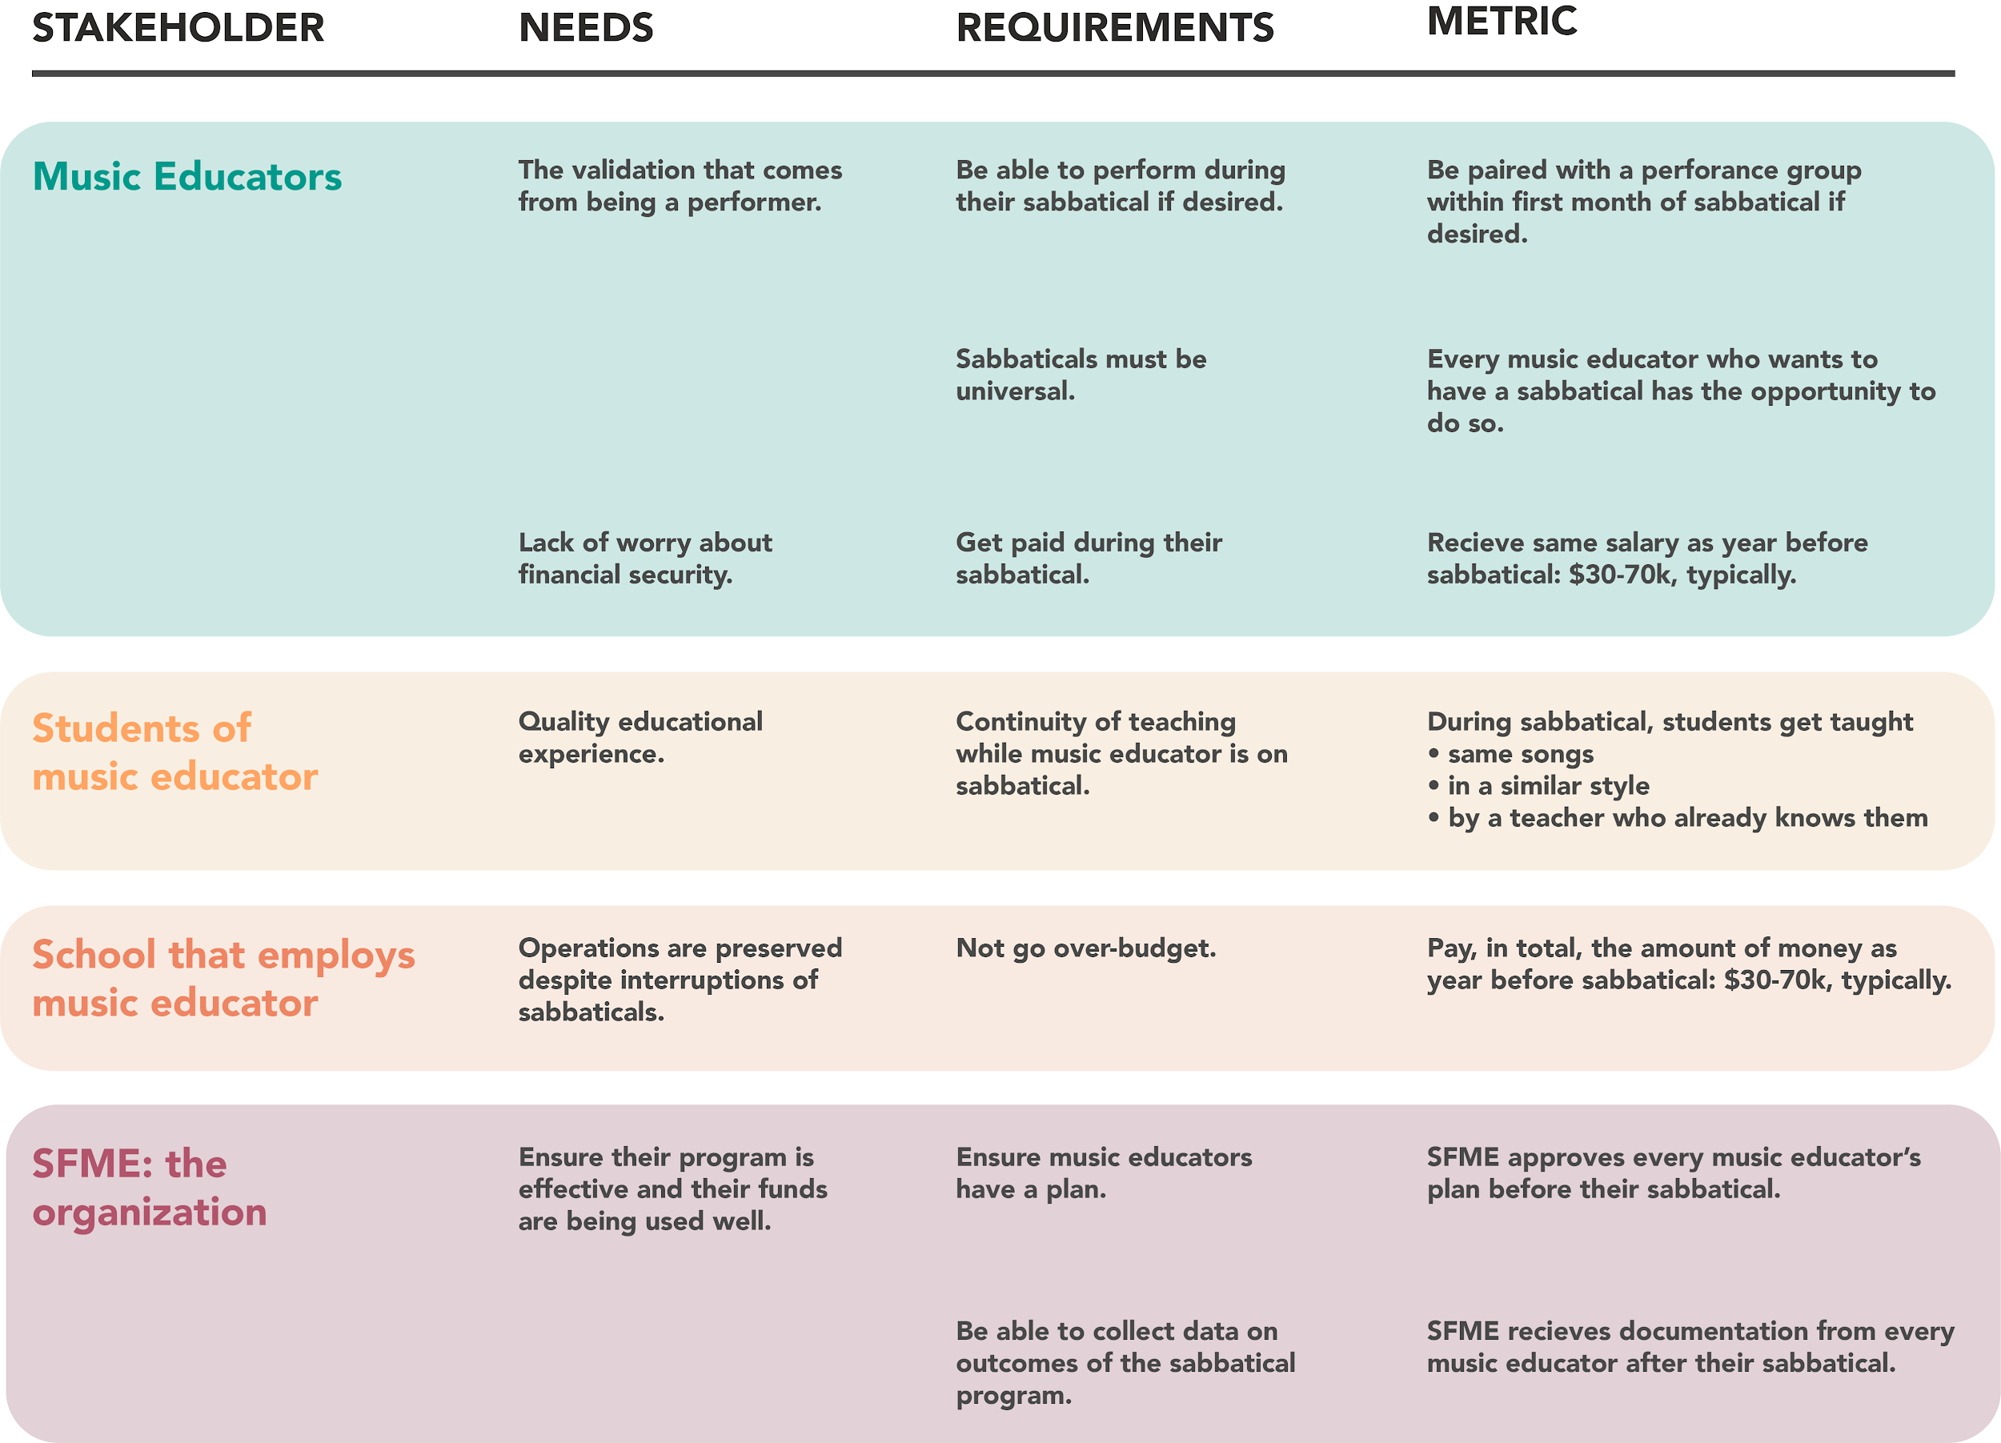
Notes:
Emma
We considered all the stakeholders
Noticed a few key barriers to implementing a universal sabbatical program in the real world
One was continuity of education for the students, and this concern came from a real music educator who we talked to in Phase 2.
The other is...money.

Slide 11
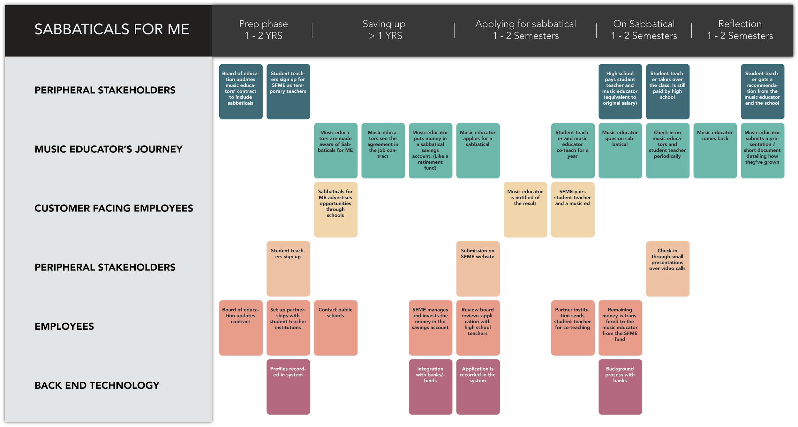
Notes:
James
This is our final service map. It represents all of the processes that happen for the different people in our organization.
It’s broken up into five phases.
We start by setting up partnerships with student teacher institutions and negotiating with the board of education to include sabbaticals in MEs job contracts
Once that’s set up, we begin advertising it in public schools. The first place a ME would see this is in the job contract when they are hired.
They then have the option to put a portion of their paycheck into our SFME fund. A large account we grow through investments whose profits we use to fund sabbaticals.
When they ME wants to take a sabbatical, they would submit a proposal online. Their school’s administration would review it and approve it. A SFME member would find a student teacher to take over for a year at the ME’s school. The ME and student teacher would then co-teach for a year to ensure continuity.
The ME goes on sabbatical and grows as an educator and as a person. SFME members would check in during their sabbatical to see how things are going
Once they come back, they submit a short representation about how their perspective has changed.
By the end, they would have realized a part of themselves they’ve always wanted to and the student-teacher would have a solid recommendation from the school.

